Slide 1
SPINAL CORD INJURY
Dr. Bamlack Shewandagn
Atlas College of Health Science
G. Surgery Department
November 2022

Slide 2
Outline
The normal anatomy of:-
Vertebral column
Spinal cord
Introduction to spinal cord injury
Assessment of spinal cord injury
Management principles of SCI

Slide 3
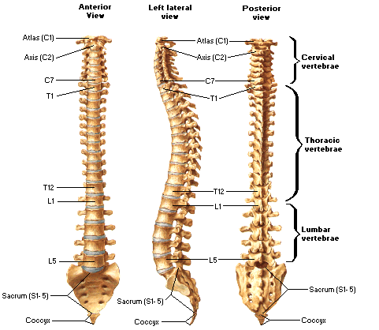
Normal anatomy of V.C
Interlocking vertebrae
Has five parts
7-cervical
12-thoracic
5-lumbar
5-sacral (fused in to one Δlar bone )
Coccyx

Slide 4
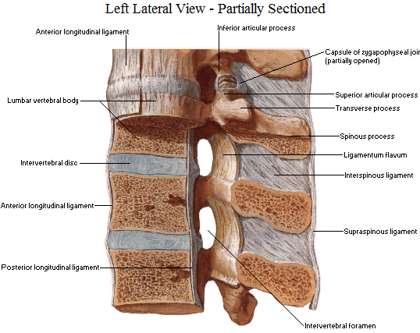
Cont’d
Each vertebrae linked by:-
Lat-facet joint
Ant-intervertebral disc
Ligaments
Ant&post Longitudinal
Interspinous
supraspinous

Slide 5
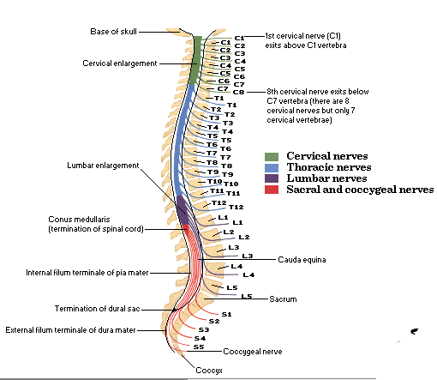
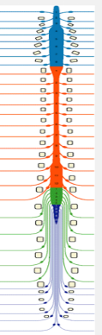
Normal anatomy of S.C
Extends from foramen magnum-L1.
Composed of 31 segments
Two areas of expansion
Cervical C3-T2
Lumbar T10-T12
Spinal nerves each
Ventral root
Dorsal root

Slide 6
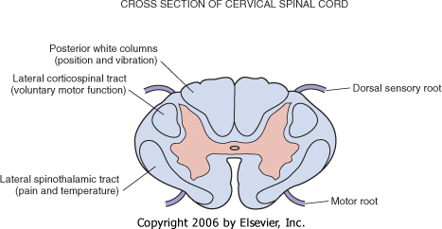
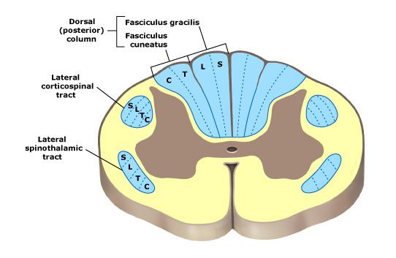
Cont’d

Slide 7
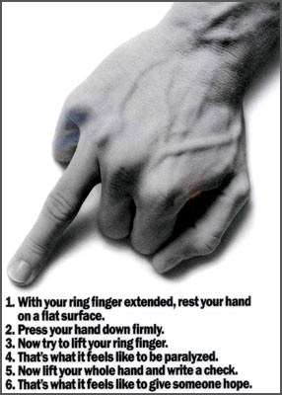
Spinal Cord Injury
An insult to SC that partially or completely compromises the main functions of the cord (motor, sensory, autonomic & reflexes). Major cause is trauma, others infection, tumor , degeneration…
Question of life or death is not a major concern in spine injuries as only few, 5-10%, die immediate to the injury w/c in turn are due to concomitant injuries than spine injury. Focus is on the ability future independent life

Slide 8
Epidemiology
Level of injury:
Goes with mobility of segments; middle & low cervical > thoracolumbar jxn > lumbar & thoracic
Other factors: age, bone & soft tissue changes
Sex & age
80-85% are males
56-61% b/n ages 15 & 30, < 15% older than 46

Slide 9
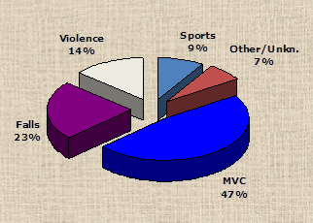
Cont’d
Etiology
RTA- 48%
Falls- 21%
Violence - 15%
Athletic injuries- 14%

Slide 10
Pathophysiology
Primary injury
When the skeletal structures fail to dissipate the energy of the primary mechanical insult, resulting in direct energy tranfer to neuronal elements.
Flexion, extension, axial loading, rotation or traction, compression
Secondary injury
Hemorrhage, edema, ischemia
Polonged hypotension and poor oxygenation

Slide 11
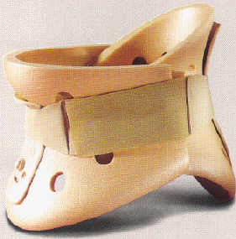
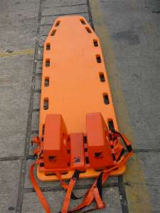
Approach to the patient
Goals of spine trauma care
Protect
Identify
Optimize conditions for recovery
ATLS: Primary Survey
Airway with c-spine stabilization
Breathing
Circulation
Disability
Exposure*
Secondary survey

Slide 12
Cont’d
Secondary survey: Hx and P/E
Suspected spinal injury: high speed, unconscious, multiple injuries, neuro deficit, tenderness
Physical exam
Inspection and palpation : occiput to coccyx
Neurological assessment

Slide 13
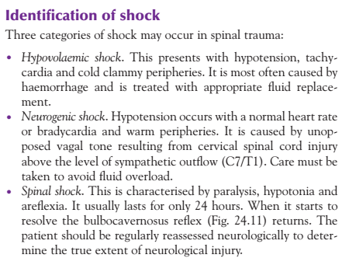
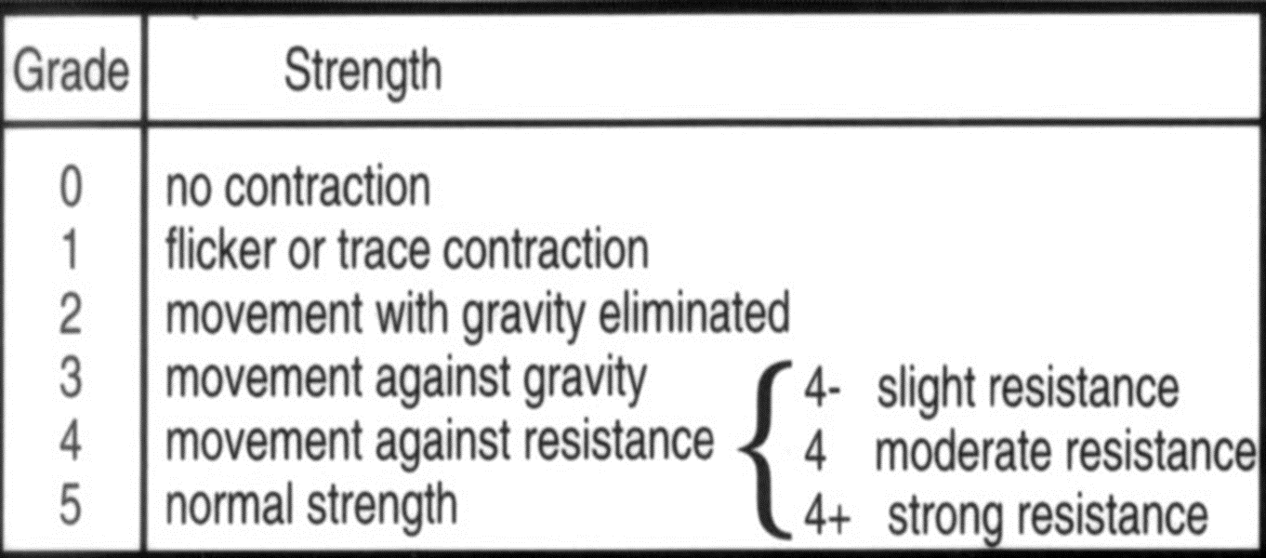
Cont’d
Neurological assessment: focus on
Motor exam
Sensory exam
Reflexes : Deep and Superficial

Slide 14
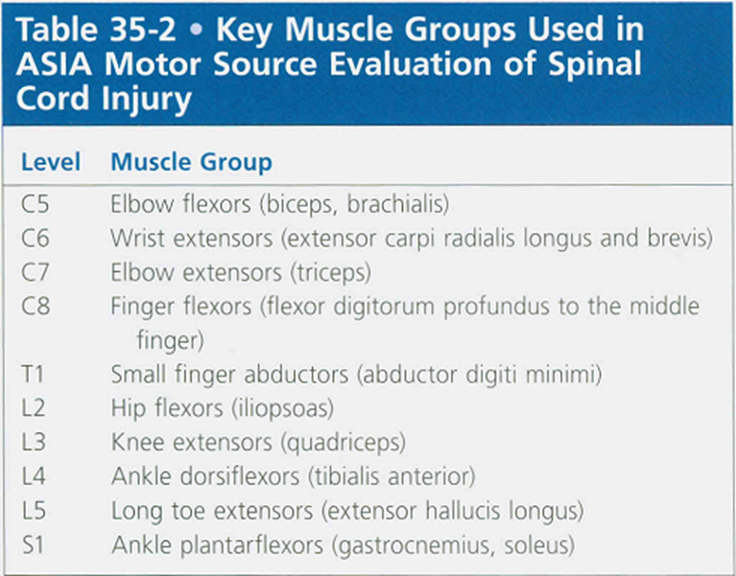

Slide 15
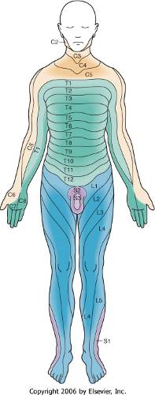
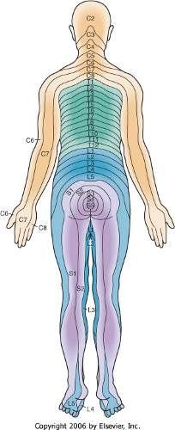

Slide 16
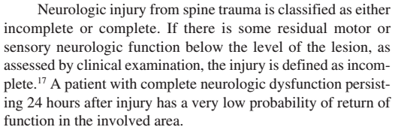
Classification
Incomplete
Complete
ASIA
Incomplete cord injury: special syndromes
Anterior cord syndrome
Central cord syndrome
Brown-Sequard syndrome

Slide 17
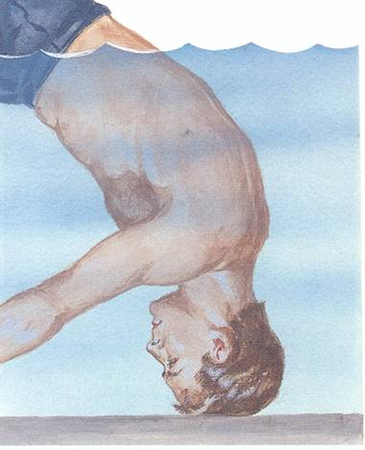
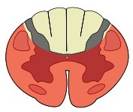

Cont’d
Anterior cord syndrome
Loss of motor, pain and temperature
Preserved proprioception and deep touch

Slide 18
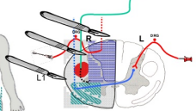
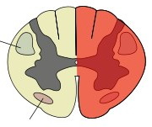
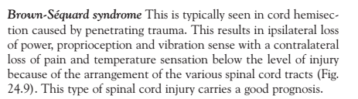
Cont’d
Loss of ipsilateral motor and proprioception
Loss of contralateral pain and temprature
Brown-Sequard syndrome

Slide 19
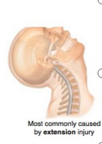
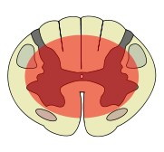
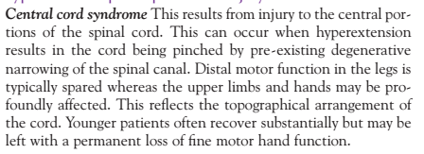
Cont’d
Upper limb weaker than lower limb
Variable sensory loss
Sacral sparing
Central cord syndrome

Slide 20

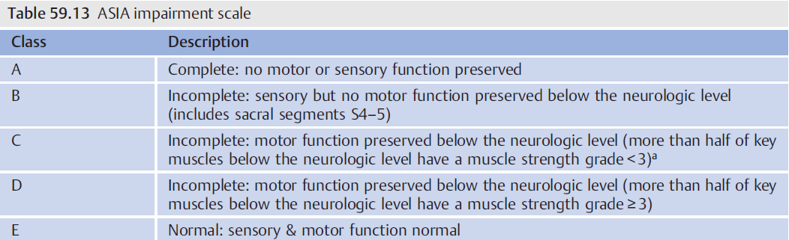
ASIA impairment scale

Slide 21
Imaging
NEXUS Criteria: 5/5 is low risk
1. Absence of tenderness in the posterior midline
2. Absence of a neurological deficit
3. Normal level of alertness (GCS score = 15)
4. No evidence of intoxication (drugs or alcohol)
5. No distracting injury/pain
Otherwise: at least XRay (AP, Lat, OMO[open mouth odontoid])

Slide 22
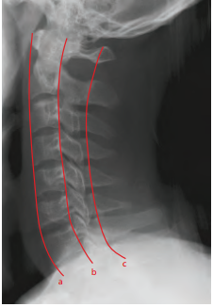
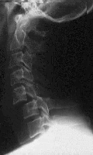
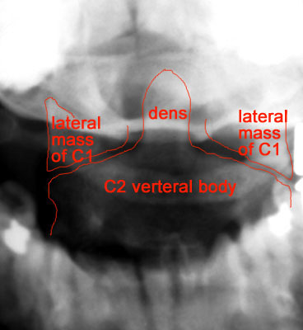
Cont’d

Slide 23
Cont’d
CT scan
The gold standard in spinal trauma and is indicated for patients with suspected or visible injuries on plain radiographs
Patients undergoing a head CT scan for closed head injury should also have a cervical screening CT.
MRI
Indicated in all cases with neurological deficit and where assessment of ligamentous structures is important

Slide 24
Management of Spinal injury
Primary goal
prevent secondary injury
Immobilization in the initial assessment
ATLS
Log roll patients

Slide 25
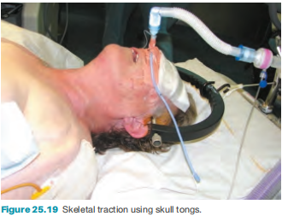
Cont’d
Principles
Spinal alignment: deformity/subluxation/dislocation > Reduction
Skull tongs
Open reduction & internal fixation
Halo brace...closed realignment

Slide 26
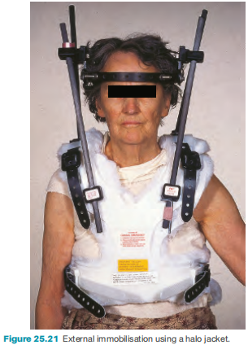
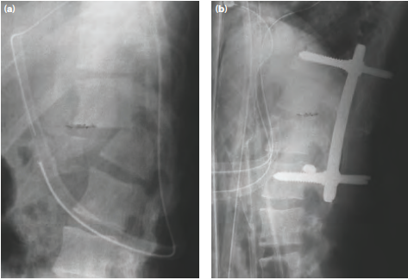
Cont’d

Slide 27
Cont’d
Spinal column stability: Unstable > Stabilization
Risk of new or further neurological injury
Neurological deficit: Deficit > Decompression
compression of the cord by bone or disc material requires surgical removal

Slide 28
Thank you

